Slide 1


Combating Tuberculosis (TB)
Using Time-Dependent Sensitivity Analysis
to Develop Strategies for Treatment and Prevention
Kendall Clark, The Park School of Baltimore
Mayleen Cortez, California State University Channel Islands
Cristian Hernandez, Regis University
Beth Thomas, St. Mary’s College of Maryland
Mentored by Dr. Allison Lewis, Lafayette College
Notes:
Hi, thank you all for joining our presentation.
I’m Mayleen Cortez, Kendall Clark, Cristian Hernandez, Beth Thomas,
and we’re going to be talking about how we can use time-dependent sensitivity analysis to develop strategies for combating Tuberculosis.

Slide 2
Our
Research
Goal
To use compartmental modeling and sensitivity analysis to determine the best method(s) of targeting tuberculosis (TB) at any point in an epidemic
Notes:
Our goal is to use compartmental modeling and sensitivity analysis to determine the best way to eradicate tuberculosis, which we abbreviate as TB.
We built a model to tell us what to target in any TB epidemic, with the goal of stopping the epidemic.
So why study tuberculosis?

Slide 3
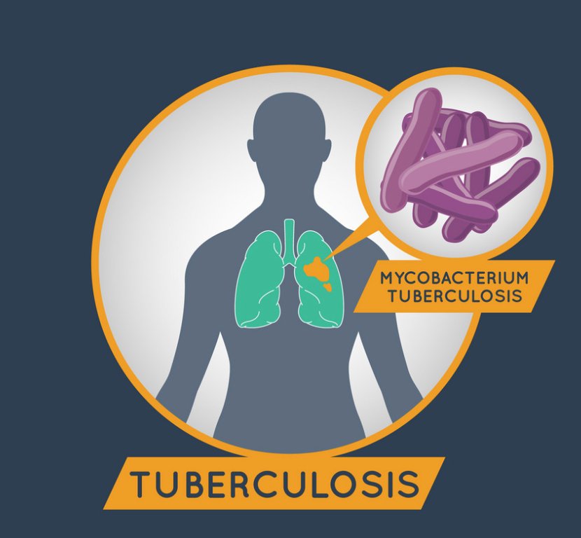
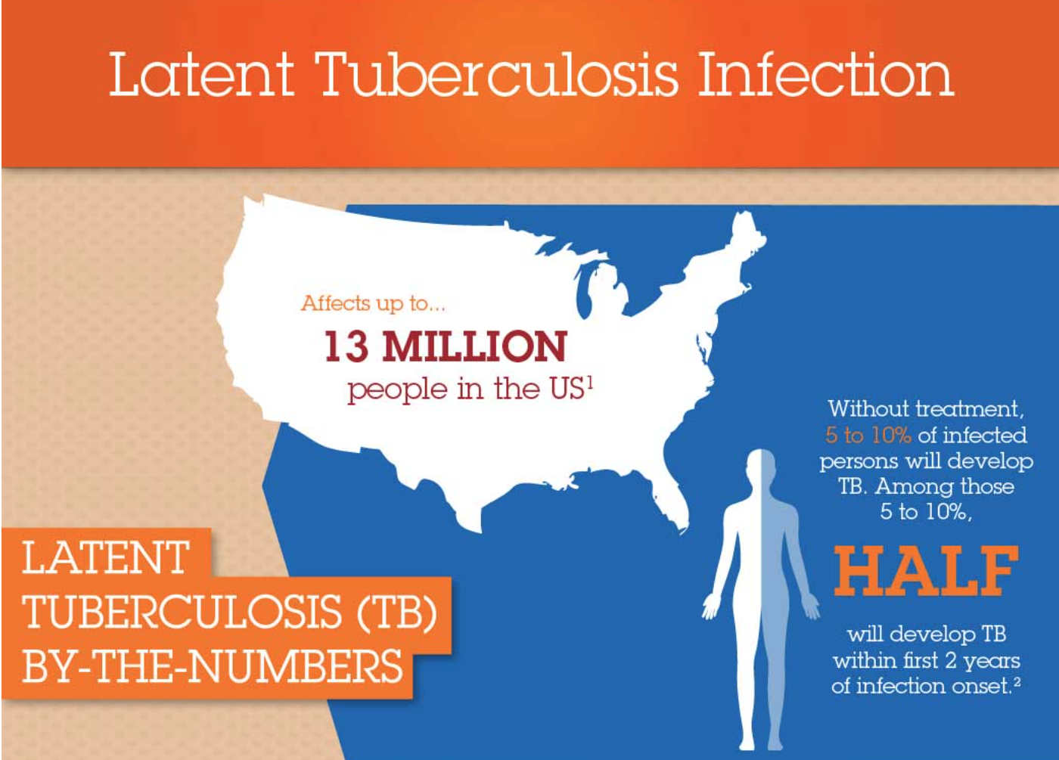
Why are we conducting this research?
Tuberculosis.”VectorStock.com.2018,https://www.vectorstock.cm/royalty-free-vector/tuberculosis-lgo-icon-vector-17791903
http://www.multivu.com/players/English/7701451-sanofi-priftin-rifapentine/
Notes:
Tuberculosis is an infectious disease that affects approx.
⅓ of the global population.
In 2016, it was actually one of the top ten causes of death worldwide, outranking HIV and malaria.
Although it is more prevalent in developing countries, no country has eradicated it so even in the US there are about 13 million people with some form of tuberculosis.
We are interested in finding a solution to this global health problem.

Slide 4
What to Expect...
Compartmental modeling overview
Our general TB model and parameters
Sensitivity analysis overview
Sensitivity analysis results
Our TB/HIV co-infection model
Sensitivity analysis results for coinfection model
Notes:
Mayleen

Slide 5
Compartmental Models
Model how materials transfer from one state to another
Popularized in 1920’s
William Kermack and Anderson McKendrick popularized modeling epidemics
  Developed the basic SIR model
S
I
R
Susceptible
Infectious
Recovered
Notes:
Beth
Compartmental Models are the foundation of our research so it’s crucial to have a good understanding on what they are. Compartmental models in general show how materials transfer from one state to another. The idea behind modeling this state change was popularized in the 1920’s by William Kermack and Anderson McKendrick. Kermack and McKendrick popularized modeling the disease spread throughout a population. Their compartmental model was an SIR model, which stands for susceptible, infectious, and recovered. All compartmental models, including the SIR model, are exclusive, meaning a person or material can only exist at one state at a time. The compartmental model we have chosen to model the spread of Tuberculosis is an SEIR model, which stands for susceptible, exposed, infectious, and recovered. It is very similar to the SIR model, however it includes the exposed state, where for the purpose of our research, an individual has come into contact with TB but is not symptomatic or contagious.

Slide 6
Assumptions for our Model
Every person is born into susceptible
Vaccinations have a 50% efficacy
Drug treatment has a 100% efficacy
Notes:
Beth
Before explaining our model it is essential to state our assumptions. Our first assumption is that every person is born into the susceptible population. This means a person cannot be born with TB or be born immune to TB. Our next assumption is that vaccinations have a 50% efficacy. This means for the population receiving the vaccine

Slide 7
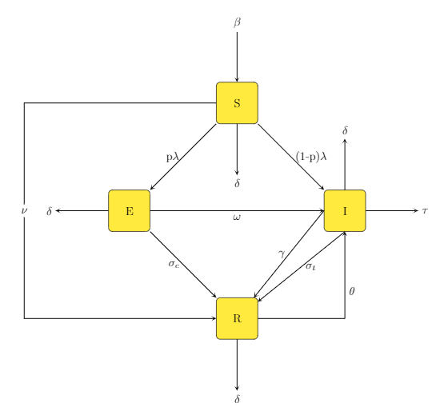
Parameter | Meaning
𝛽 | Birth rate
𝝀 | Rate of infection
𝛾 | Natural rate of recovery
𝛿 | Natural death rate
𝜔 | Rate of deterioration
𝜏 | Death rate due to TB
𝜃 | Relapse rate
𝜈 | Vaccination rate
𝜎_{c} | Treatment rate (latent)
𝜎_{t} | Treatment rate (active)
β
S
𝛿
p
Slow TB contraction rate
p𝜆
(1-p)𝜆
𝛿
𝜈
E
I
𝜏
⍵
𝛾
𝜎_{c}
𝜎_{t}
θ
R
𝛿
Notes:
Beth
To construct our SEIR model we begin with the four states and take into account how people enter, leave, and transition states.
Mention difference between slow-track and fast-track TB.

Slide 8
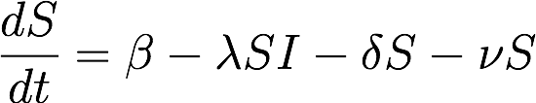
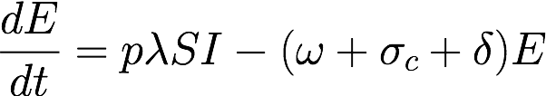
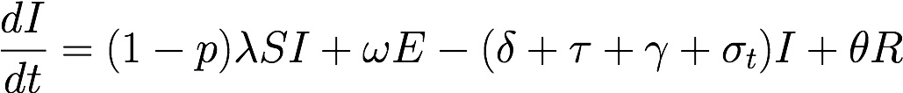
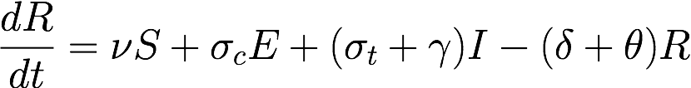
System of Ordinary Differential Equations
Notes:
Cris
> These equations show the rate of change of the different states.
> For example, dS/dt models the rate of change of the susceptible population over time (in years).
> We built the equations by considering what goes in and out of the population> As you can see here, the first term is -lambda*SI.
> This represents the susceptible population interacting with the infected population at a rate of negative lambda.
> In other words, we have people leaving our S population, when they have some sort of interaction with an infected person, and moving to the E population at a rate of lambda.
> This balancing out repeats throughout the equations, where you see people leaving a population to join another.
> The second term represents births being added to the susceptible population, while the third and fourth terms represent people leaving the population at the rates of delta and nu, respectively.
> That shows the people dying of natural causes during the S state and those being vaccinated to join the R stage.
> The rest of the equations have similar interpretations.

Slide 9
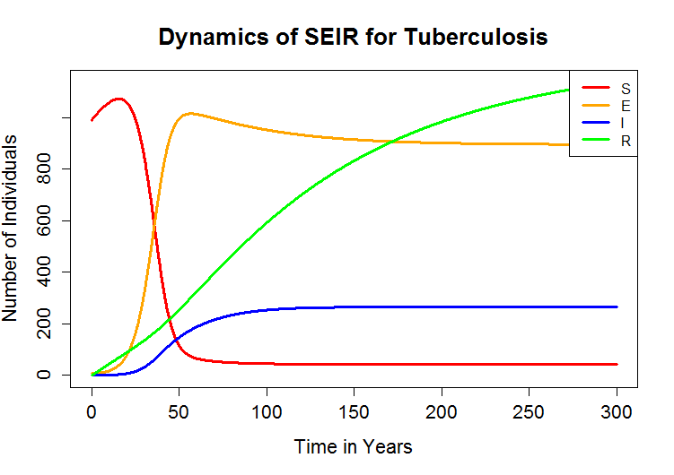
SEIR Graph
Initial Population: 1000 people
Susceptible population: 990 people
Exposed population: 10 people
Notes:
Beth
From the four ODE’s and nominal values we can plot the dynamics of our four populations over time. We begin by setting initial conditions. For the purpose of this graph we have an initial population of 1000, 990 are susceptible and 10 exposed, so very close to the start of an epidemic. From here we shall develop a roadmap to sensitivity analysis so we can determine which of the parameters are driving the increased exposed and infectious populations.

Slide 10
Sensitivity Analysis Roadmap
Sensitivity analysis– the study of how parameters impact the output of a mathematical model
Scalar Output Function
Partial Derivatives estimated with Finite Differences
Gradient Vector and Matrix
Active Subspace– provides information on most impactful parameters
Notes:
Cris
Now we’ll talk about sensitivity analysis, which is the study of how parameters impact the output of a mathematical model.
In our case, how changing our 7 parameters in any combination affects the population dynamics of our SEIR model.
Before we can do anything, we need a function to analyze. We chose a function that outputs scalar value.
This allows us to approximate partial derivatives using finite differences.
We need that in order to build our gradient vectors and matrix.
And finally that will allows us to look at the active subspace.

Slide 11
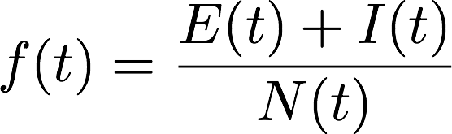
Scalar Output Function
Models exposed and infectious populations as a proportion of total
How can we analyze this function if our parameters are not displayed in an analytical form?
E : Exposed population
I : Infectious population
N : Total population
Notes:
-Cris
We are conducting sensitivity analysis on this function f(t)
-This equation gives us the proportion of the total population that is either exposed or infected at any given time step during the epidemic
Need to explain why we choose this scalar function
- E stands for exposed, or latent
- I stands for infectious
- and N represents our total population
- ideally we will use our model to find the combinations of parameters that get this output to be 0.

Slide 12
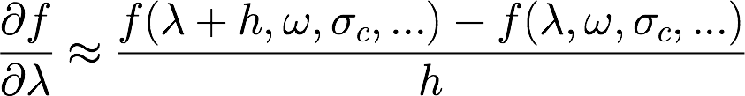
Partial Derivatives using Finite Differences
Finite differences
Are basic difference equations used to estimate partial derivatives
Approximation of partial derivative with respect to lambda
Notes:
Cris
To conduct sensitivity analysis, however, we need to take the partial derivatives of our function with respect to each parameter. Since we cannot directly take this partial derivative, we use finite differences. Finite differences approximate the partial derivative.
If you look here at our finite difference example for beta, birth rate, you might notice we actually calculate the slope of a secant line.
We take our function evaluated at lambda, take our function evaluated at lambda plus h, take the difference and divide by h, where our “h” is a really really small step size, to have an accurate approximation. These finite differences lead into our discussion about gradient vectors and matrices, but before that, let’s talk a little bit about time.

Slide 13
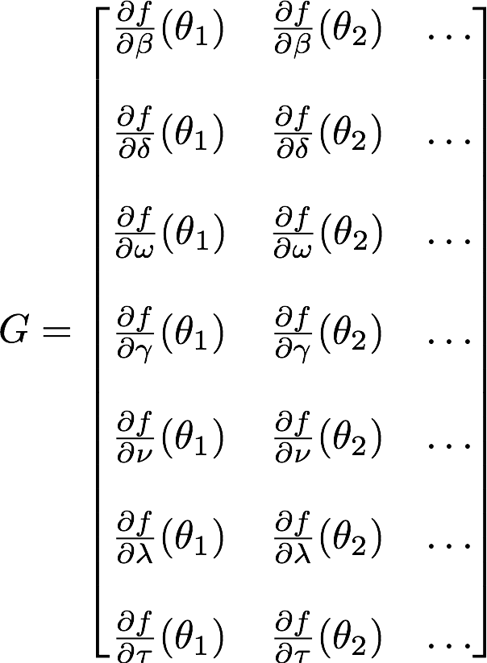
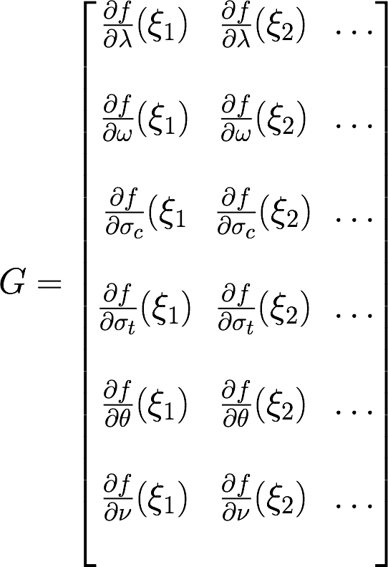
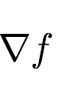
Gradient Vector and Matrix
Combines partial derivatives of a multivariable function into a vector
)
6x250 matrix
Active subspace is derived from gradient matrix.
Notes:
Since we don’t want to analyse 6 separate partial derivatives we compute a gradient vector that looks at all 6 partial derivatives with respect to our parameters at once. The gradient vector is 6x1. We want to look at multiple samples in order to get accurate results. We created ranges that range 20% above and below our nominal. To do this effectively we use a gradient matrix that allows us to take many samples from our established ranges.
-----
The gradient vector holds the partial derivatives of one particular sample, with respect to each parameters.
We create a gradient at each time we are interested in looking at.

Slide 14
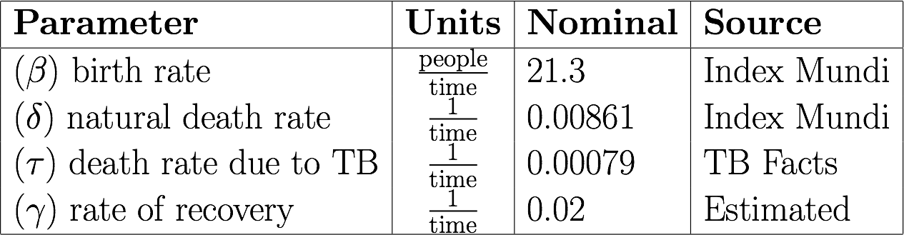
Table of Fixed Values
Notes:
Cris
We have set fixed values for certain parameters that we cannot control. First of we have Beta the birth rate. According to Index Mundi, a website that keep track of South African population demographics, the crude birth rate is 21.3 births per 1000. There are ways we can control the birth rate but it is not realistic. Here we have the natural death rate, death rate due to tuberculosis, and the natural rate of recovery from tuberculosis. We estimated gamma based our SEIR graphs that will be shown soon.

Slide 15
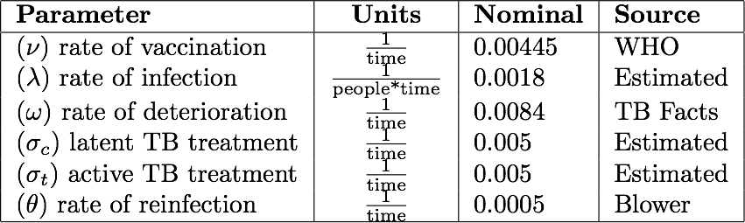
Table of Parameter Values
Notes:
Cris
Here we have the parameters that we will focus on analyzing to determine where we should focus time and energy. We want to see if vaccination is important in eradicating tuberculosis. Should we focus mainly on the rate of infection? Maybe the rate of deterioration to the active tuberculosis infection is a greater threat. Is there a difference of impact of when treatment is administered? Or should we focus on keeping healthy people healthy after recovering from tuberculosis?

Slide 16

Singular Value Matrix Decomposition
Singular Value Decomposition (SVD)
Factors the gradient matrix into three matrices
SVD Formula
Parameter Information
Provides information for isolating the active subspace
Singular Values
Sample
Information
Notes:
Kendall

Slide 17
What’s an Active Subspace?
A dimension reduction technique which isolates the parameter combinations that are most significant to a scalar output
  One dimensional active subspace- coefficients from the first column of U are used as sensitivity metrics
Can have many dimensions when multiple parameter combinations are impactful
Notes:
Kendall
Define directions most important to function
Overall goal is to rank original params in order of significance
1-d subspace allows us to use param coefficients as significance metrics for each parameter
Multidimensional active subspaces tell us that there are multiple directions which are impactful to the scalar output...column coefficients are orthagonals, so the same parameters may be of different significance in each of the linear combinations. ...therefore we need a
Use activity scores to pull info from each significant dimension

Slide 18
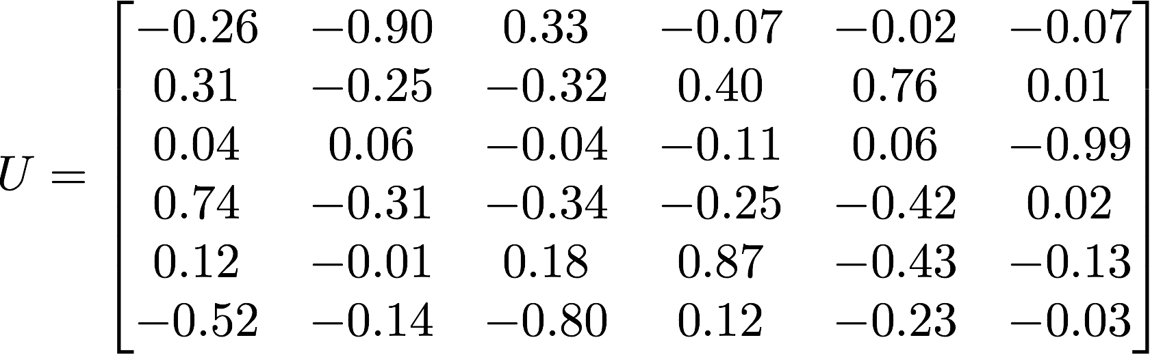
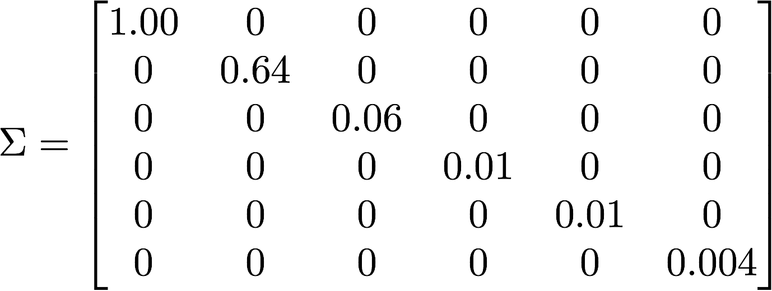
Our Active Subspace
Recall the singular value decomposition formula:
First two columns = active subspace
Where is the first significant split in diagonal values?
Two Dimensional
Notes:
Kendall
Note: data from year 68

Slide 19
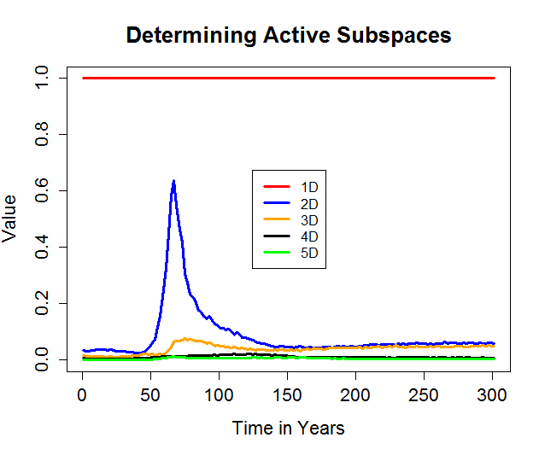
Is Our Active Subspace Always Multidimensional?
Graphed singular values at each time step
2-D active subspace occurs around t=50 through t=100
Also slight increase in 3rd singular value
σ₁
σ₂
σ₃
σ₄
Singular Values
Notes:
Kendall
Remember blip in 3rd singular value so we did activity scores for a 3d active subspace, just incase

Slide 20
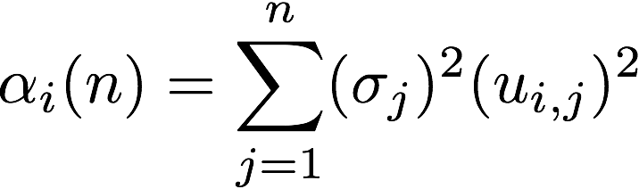

Activity Scores
Combines information from multiple columns into a single sensitivity metric
n= number of dimensions
i= any parameter i
=singular values
= item of U matrix
Take each coefficient of each active vector and weigh them according to their singular value
Sum them to get an activity score
Notes:
Cris
Activity scores are a way for us to take into account multidimensional active subspaces. This means we take into account the multiple columns in the U matrix, in our case three.
Here we have the formula we used to calculate activity scores. N is the number of dimensions, i is the parameter we are on, and sigma squared are our eigenvalues, u of i , j is an item of the U matrix. We take each coefficient of each active vector and weight according to its singular value and combine them to get an activity score for each parameter

Slide 21
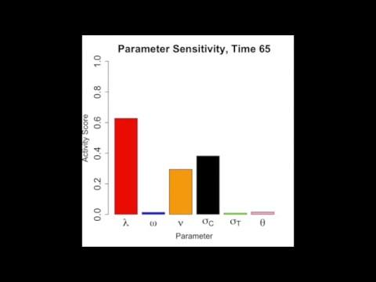
The Significance of our Parameters Over Time
Parameter | Meaning
𝜆 | Infection rate
𝜔 | Rate of deterioration
𝜈 | Vaccination rate
𝜎_{C} | Active treatment rate
𝜎_{T} | Latent treatment rate
𝜃 | Relapse rate
Notes:
Cris
Lamba is very significant in the beginning. As time passes other parameters become important. Nu and sigma c spike up. Theta becomes a significant near the end.

Slide 22
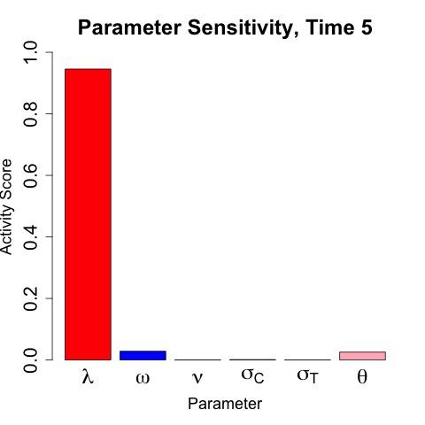
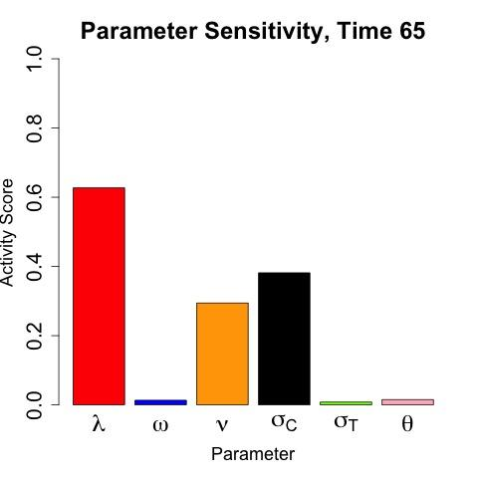
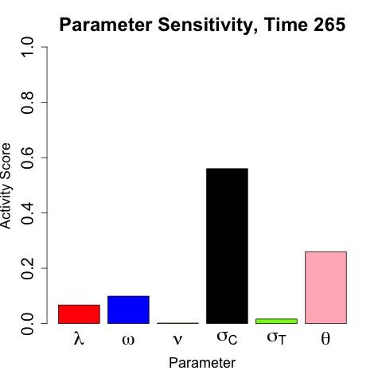
Methods of Targeting TB Based on our Results
Latent treatment (𝜎_{c})
Vaccination rate (𝜈)
Rate of infection (λ)
Relapse Rate (θ)
Notes:
Kendall

Slide 23
Where Do We Go From Here?
How can we make a more comprehensive model?
TB/HIV co-infection model
  To more accurately show population dynamics of a TB epidemic in an environment where HIV is prevalent
  people with HIV = more likely to die from TB than AIDS
Notes:
Kendall

Slide 24
Assumptions For This Model
Every person is born susceptible
Vaccinations have a 50% efficacy
Drug treatment has a 100% efficacy
HIV incidence rate remains the same for all populations
Notes:
Mayleen
As before, all people are born susceptible to Tuberculosis. In other words, people are never born with tuberculosis or immune from tuberculosis. Vaccinations have 50% efficacy and drug treatment has 100% efficacy, although it is not administered to everyone. Now we also have the assumption that the HIV incidence rate remains the same for all populations. In other words, a person in any of the HIV- populations has the same chance of contracting HIV as any other person.

Slide 25
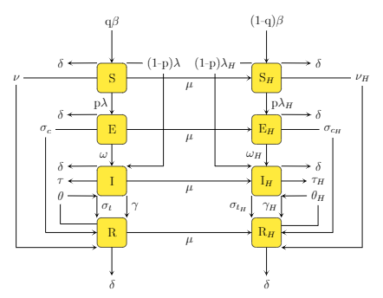
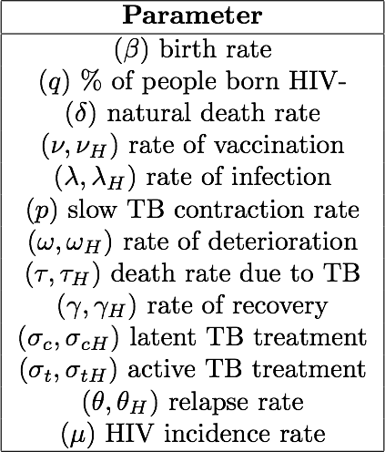
Notes:
Here we have illustrative figure of our expanded model.
There is a lot going on in this slide, so bear with me, I will be going through it parameter by parameter.
We still have susceptible, exposed, infectious and recovered states as before, but now we have split them into HIV- and HIV+ populations.
We also have many of the same parameters, but their values may have changed for the HIV+ population and so you will see some denoted with a subscripted H.
Beta is still our birth rate, but we have added a parameter q to take into account those who are born HIV- versus those who are born HIV+.
The parameter q is the percent of people who are born HIV-.
So you can see q percent of beta going into the HIV- susceptible population and (1-q) percent of beta going into the HIV+ susceptible population.
Delta, our natural death rate, continues to represent those naturally dying out of each population, you can see it leaving each state.
Nu, as before, is the rate of vaccination and takes those from the susceptible to the recovered state.
Lambda once again represents our rate of infection and you can see we have p as before to represent those who go from the susceptible to the exposed state.
I’ll remind this is called slow-track Tuberculosis. 1-p represents those who go from S directly to I, which is called fast-track TB.
Her we have omega, the rate of deterioration, tau, the death rate due to Tuberculosis, and gamma, the rate of natural recovery.
Sigma c and sigma t, which treat latent and active tuberculosis respectively, are also shown here, taking individuals from E to R and from I to R.
We also have theta, the rate of relapse representing those who go from recovered back to infectious.
Lastly, we have added mu, the HIV incidence rate.
It represents people from each HIV- population that are contracting HIV.
The ordinary differential equations we used to model this system are very similar to the equations we have for our general TB model.
We can show them to anyone who is interested in taking a look after today’s talk.

Slide 26
Notes:
Here we have illustrative figure of our expanded model.
There is a lot going on in this slide, so bear with me, I will be going through it parameter by parameter.
We still have susceptible, exposed, infectious and recovered states as before, but now we have split them into HIV- and HIV+ populations.
We also have many of the same parameters, but their values may have changed for the HIV+ population and so you will see some denoted with a subscripted H.
Beta is still our birth rate, but we have added a parameter q to take into account those who are born HIV- versus those who are born HIV+.
The parameter q is the percent of people who are born HIV-.
So you can see q percent of beta going into the HIV- susceptible population and (1-q) percent of beta going into the HIV+ susceptible population.
Delta, our natural death rate, continues to represent those naturally dying out of each population, you can see it leaving each state.
Nu, as before, is the rate of vaccination and takes those from the susceptible to the recovered state.
Lambda once again represents our rate of infection and you can see we have p as before to represent those who go from the susceptible to the exposed state.
I’ll remind this is called slow-track Tuberculosis. 1-p represents those who go from S directly to I, which is called fast-track TB.
Her we have omega, the rate of deterioration, tau, the death rate due to Tuberculosis, and gamma, the rate of natural recovery.
Sigma c and sigma t, which treat latent and active tuberculosis respectively, are also shown here, taking individuals from E to R and from I to R.
We also have theta, the rate of relapse representing those who go from recovered back to infectious.
Lastly, we have added mu, the HIV incidence rate.
It represents people from each HIV- population that are contracting HIV.
The ordinary differential equations we used to model this system are very similar to the equations we have for our general TB model.
We can show them to anyone who is interested in taking a look after today’s talk.

Slide 27
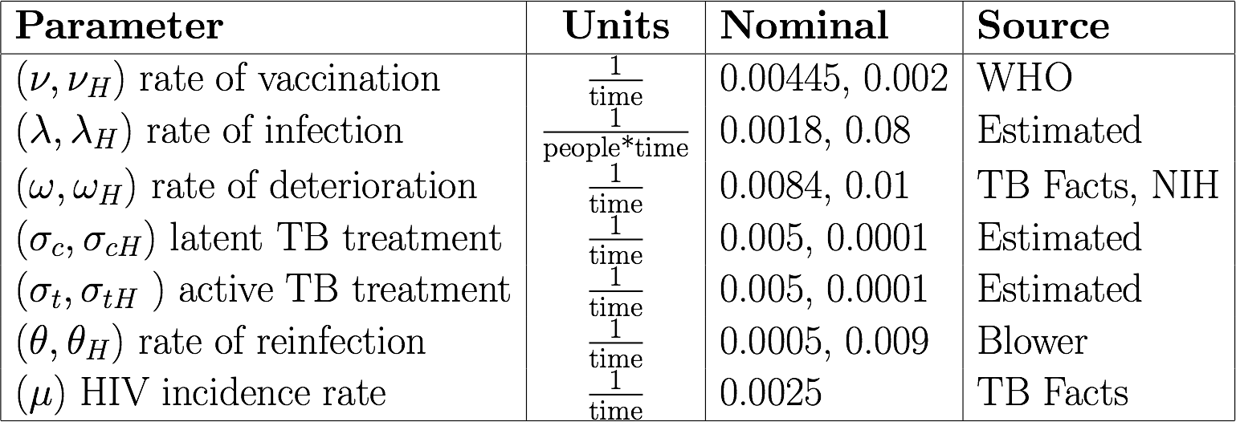
New Parameter Values
Notes:
We kept the same nominal values for the parameters that affect the HIV- population as for our general TB model, but we did change these values for the HIV+ population.
For example, you can see here that nu and nu sub H have different values.
I’d like to point out that the reason some of these values changed for the HIV positive population is that HIV weakens the immune system.
So for example, the rate of deterioration from latent to active TB is a lot larger for a person with HIV because of their weakened immune system.
In other words, they are getting sick faster.
Each of these parameters on the screen also has a respective range associated with it, where the lower bound is 20% less than the nominal value and the upper bound is 20% above the nominal value.
These ranges, once again, are important for us when conducting our sensitivity analysis.

Slide 28
New Parameter Values
Notes:
We kept the same nominal values for the parameters that affect the HIV- population as for our general TB model, but we did change these values for the HIV+ population.
For example, you can see here that nu and nu sub H have different values.
I’d like to point out that the reason some of these values changed for the HIV positive population is that HIV weakens the immune system.
So for example, the rate of deterioration from latent to active TB is a lot larger for a person with HIV because of their weakened immune system.
In other words, they are getting sick faster.
Each of these parameters on the screen also has a respective range associated with it, where the lower bound is 20% less than the nominal value and the upper bound is 20% above the nominal value.
These ranges, once again, are important for us when conducting our sensitivity analysis.

Slide 29
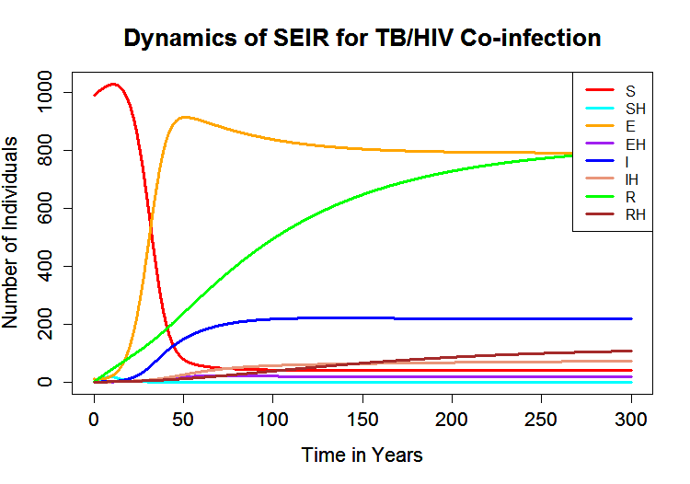
SEIR Dynamics (Co-infection Model)
Notes:
Using these nominal values, we plotted the dynamics of the 8 populations over time.
For our initial conditions, we once again started with a total of 1000 people, where 990 were susceptible and 10 were exposed.
The whole population started HIV-.
You may wonder why our initial population did not include individuals with HIV.
We did this to account for the start of both epidemics.
From here, we move on to the sensitivity analysis for our new model.

Slide 30
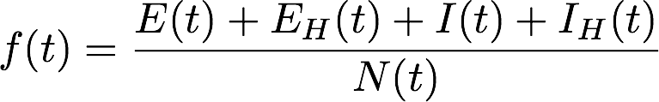
Updated Scalar Output Function
E : Exposed population
I : Infectious population
N : Total population
Notes:
As a quick refresher, to conduct sensitivity analysis, we needed a function to analyze.
We modified our original function to fit our new model, so it still gives us the proportion of the population that is either exposed or infectious at any given time and now includes the exposed and infectious HIV+ populations.

Slide 31

Sensitivity Analysis
Sensitive Parameter | Meaning
𝜆 | Infection rate
𝜔 | Rate of deterioration
𝜈 | Vaccination rate
𝜎_{C} | Active treatment rate
𝜎_{T} | Latent treatment rate
𝜃 | Relapse rate
𝜇 | HIV incidence rate
Notes:
Beth
After following the same roadmap previously discussed for our non-HIV model, we conduct sensitivity analysis on the new model to know which parameters are driving our new scalar output function. Here is a video compiled over a span of 300 years showing which parameters are driving our function at different times.

Slide 32
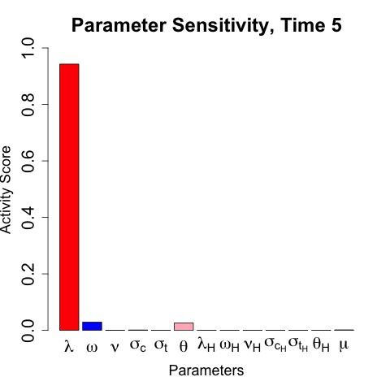
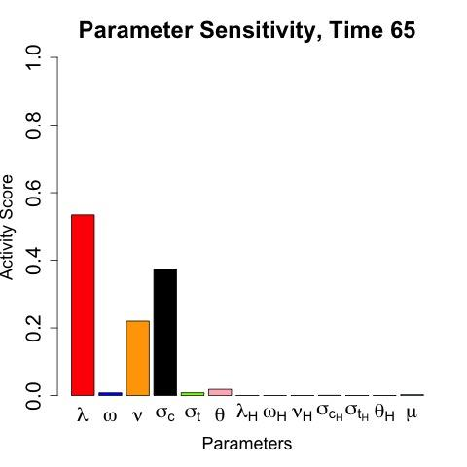
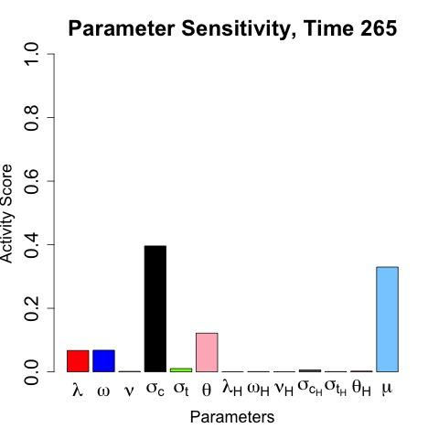
Results For Our Co-infection Model
Rate of infection (λ)
Latent treatment (𝜎_{c})
Vaccination rate (𝜈)
HIV incidence rate (𝜇)
Notes:
Beth
HIV spreads through unsafe sexual practice and dirty needles so by emphasizing and educating people about the importance of safe sex and sterile medicinal practices, we can decrease mu.
*note: the other aren’t significant because our initial population does not include any HIV+ people. Over time, people enter the HIV+ populations through mu, however it is not significant enough timespan during our time span.

Slide 33
Summary
Our goal:
To use compartmental modeling and sensitivity analysis to determine the best method(s) of targeting tuberculosis (TB) at any point in an epidemic
Notes:
As you may recall, our goal in conducting this research has been to use compartmental modeling and sensitivity analysis to determine the best way to eradicate tuberculosis.
We’ve discussed two models: one to represent a tuberculosis epidemic where HIV is not prevalent and one to represent a tuberculosis epidemic where HIV is prevalent.

Slide 34
Notes:
We’ve discussed two models: one to represent a tuberculosis epidemic where HIV is not prevalent and one to represent a tuberculosis epidemic where HIV is prevalent.
Using time-dependent sensitivity analysis via active subspaces, we have found that what we need to target throughout an epidemic changes over time.

Slide 35
Notes:
At the start of an epidemic, our research has shown it is important to limit the spread of disease by targeting the contact and infection rate, and towards the end we have seen that targeting latent tuberculosis or the spread of HIV can be very important.
We hope this research continues and can assist medical professionals in understanding and knowing what the best methods for targeting tuberculosis in any epidemic are.
Thank you.

Slide 36
References
Blower, S. M., Mclean, A. R., Porco, T. C., Small, P. M., Hopewell, P. C., Sanchez, M. A., & Moss, A. R. (1995). The intrinsic transmission dynamics of tuberculosis epidemics. Nature Medicine,1(8), 815-821.
doi:10.1038/nm0895-815
Constantine, P. G., & Diaz, P. (2017). Global sensitivity metrics from active subspaces. Reliability Engineering & System Safety, 162, 1-13. doi:10.1016/j.ress.2017.01.013
Chaisson, R. E., & Churchyard, G. J. (2010, March 01). Recurrent Tuberculosis: Relapse, Reinfection, and
HIV | The Journal of Infectious Diseases | Oxford Academic. Retrieved June/July, 2018, from https://academic.oup.com/jid/article/201/5/653/861944
Global tuberculosis report 2017. (2017, December 06). Retrieved from http://www.who.int/tb/ publications/global_report/en/

Slide 37
References
Kozicharow, Allison, and Bernice Born. “WiRED International Launches Airborne Diseases Module.” WiRED Launches Prevention Education Program on Ebola in East Africa/WiREDInternational.org, WiRED International Health Education and Information, www.wiredinternational.org/Airborne _Diseases_Module_Launched.html.
Newswire, MultiVu - PR. “Sanofi Launches New Priftin® (Rifapentine) Packaging.” Multivu, Sanofi, www.multivu.com/players/English/7701451-sanofi-priftin-rifapentine/.
South Africa Birth rate. (n.d.). Retrieved July 23, 2018, from https://www.indexmundi.com/south_ africa/birth_rate.html
TB Facts | TB, tests, drugs, statistics. (n.d.). Retrieved July 23, 2018, from https://www.tbfacts.org/

Slide 38

Acknowledgements
Special thanks to the following people and organizations for making our research possible:
Dr. Allison Lewis
St. Mary’s College of Maryland ESP-REU 2018
National Science Foundation DSM -1560301

Slide 39



Contact Information
Kendall Clark
kendallc19@parkschool.net
The Park School of Baltimore
Add photo
Cristian Hernandez
chernandez016@regis.edu
Regis University
Mayleen Cortez
cortezmayleen@gmail.com
California State University
Channel Islands
Beth Thomas
bethomas@smcm.edu
St. Mary’s College of Maryland
Add photo

Slide 40
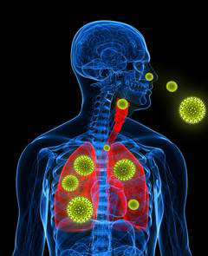
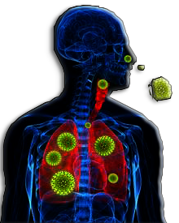
How TB Spreads and Treatment Approaches
Airborne disease
Prevented or treated with:
  Quarantine
  Vaccinations
  Drug treatment
Image Credit:
http://www.wiredinternational.org/Airborne_Diseases_Module_Launched.html
Notes:
Kendall

Slide 41
